Slide 1
Applied Research Laboratories
Group f15e4
Heena narottam, ryan spiegelman, and marcus cruz

Slide 2
Data Models
Concept to reality

Slide 3
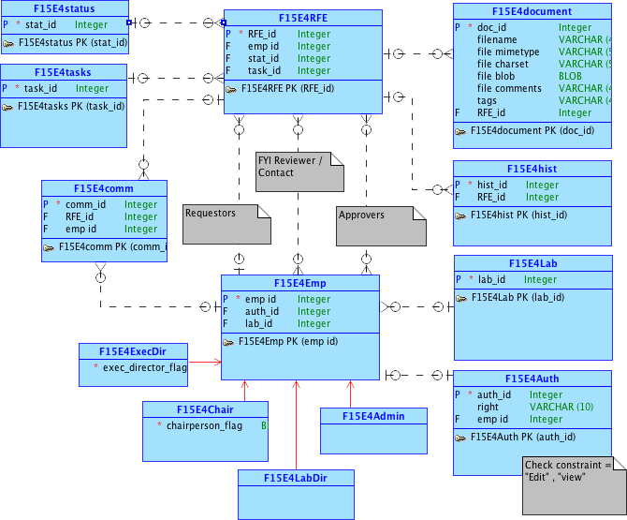
Notes:
conceptual

Slide 4
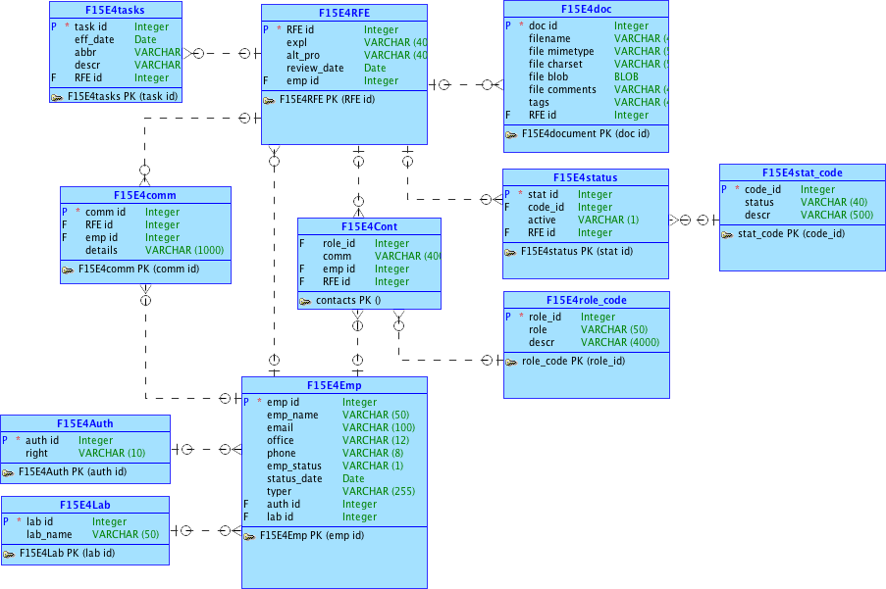
Notes:
logical

Slide 5
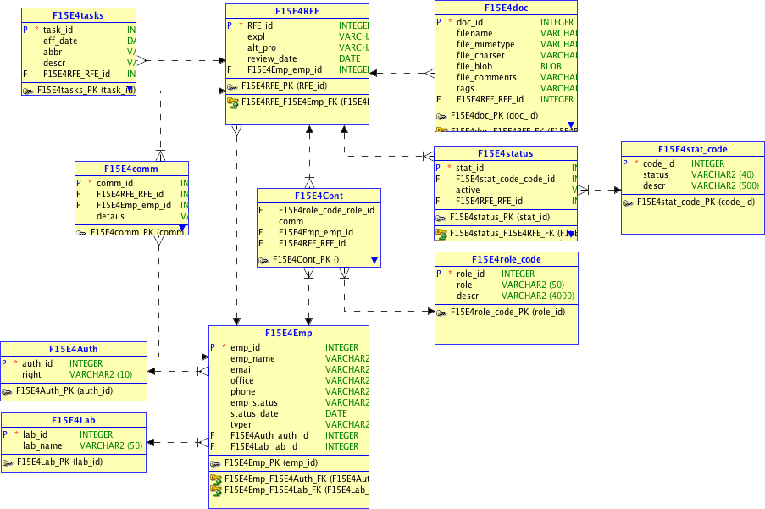
Notes:
Relational

Slide 6
Our Application
Applied research laboratory proposal

Slide 7
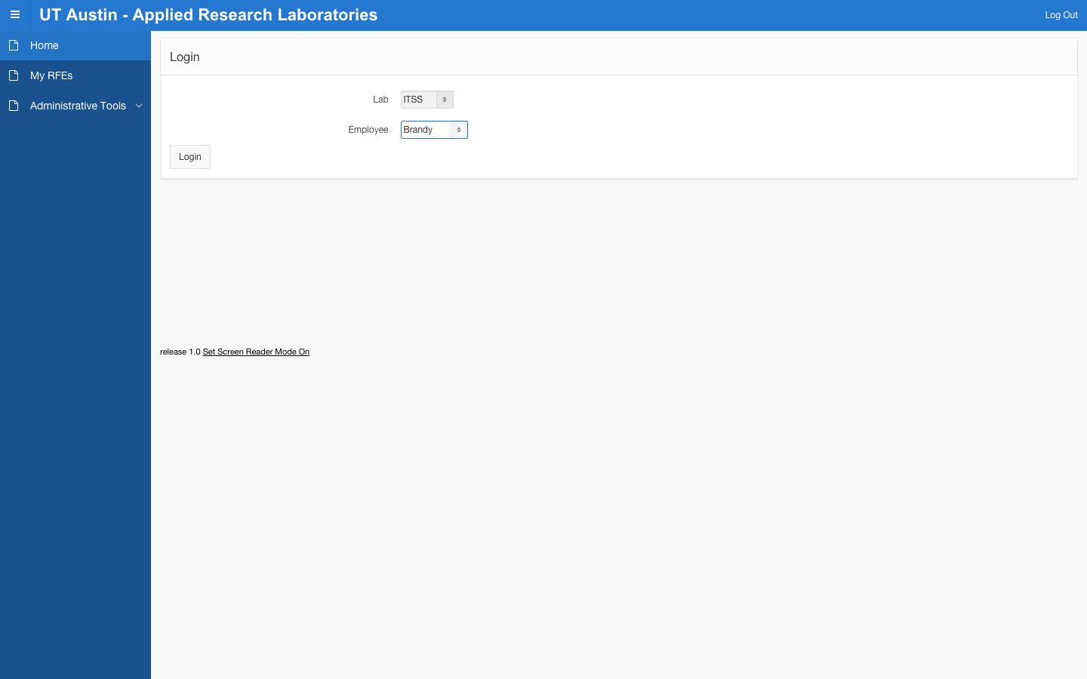
Notes:
https://apex.oracle.com/pls/apex/f?p=97580:1:11379693372433

Slide 8
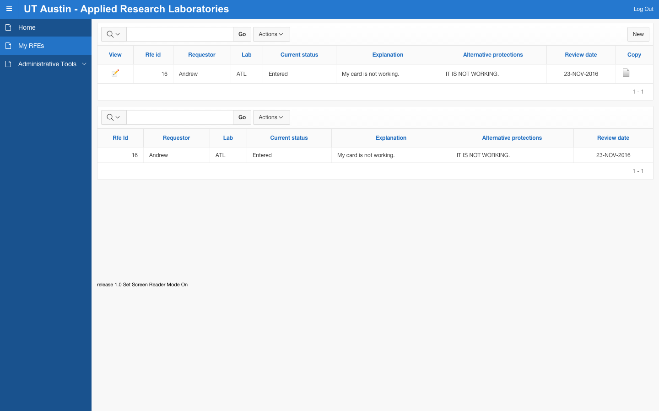

Slide 9
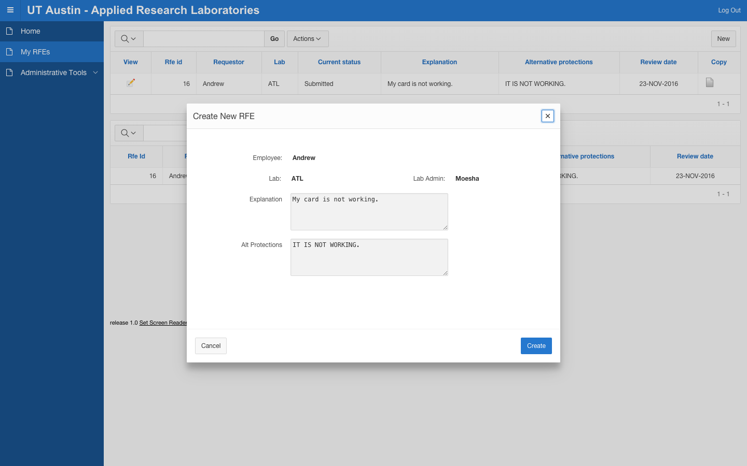

Slide 10
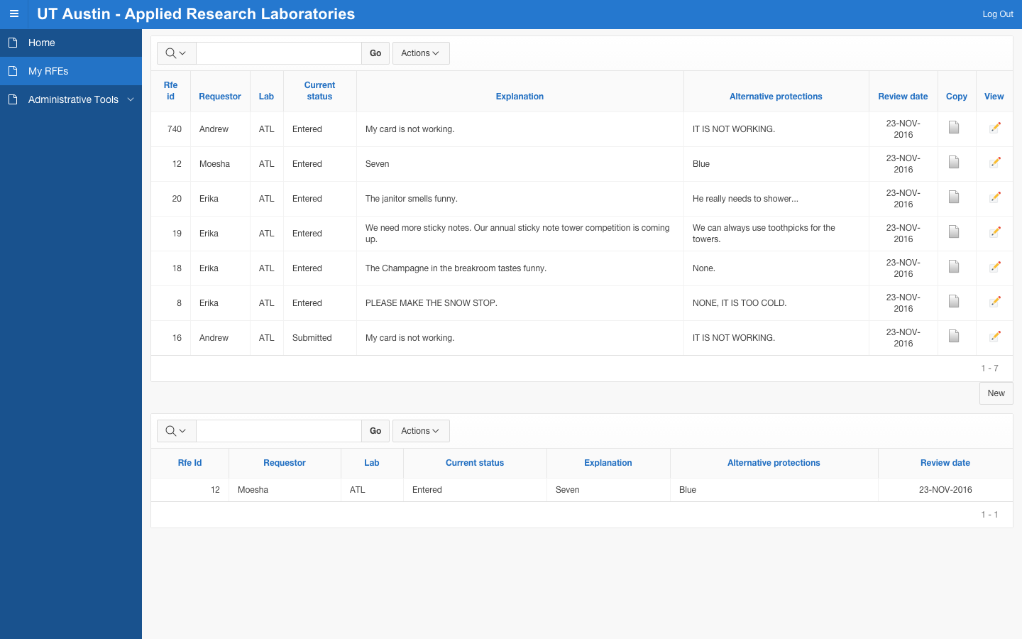

Slide 11
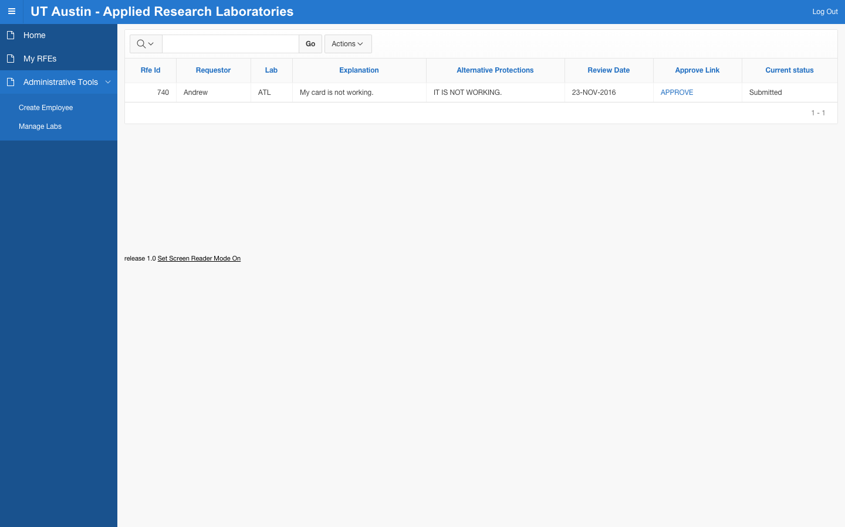

Slide 12
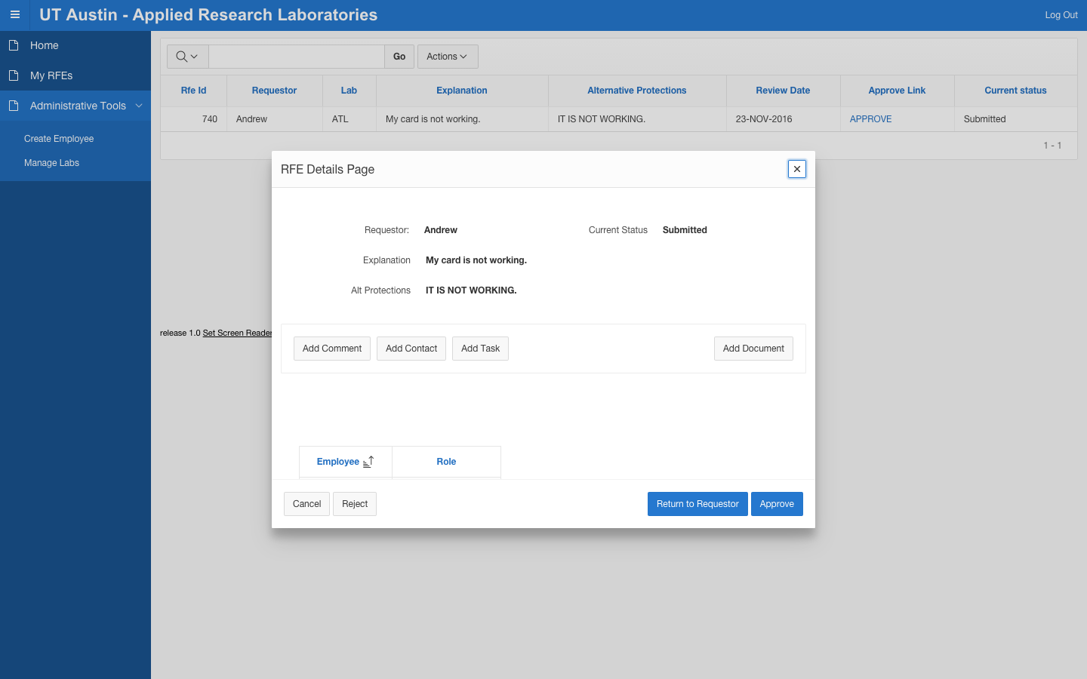

Slide 13
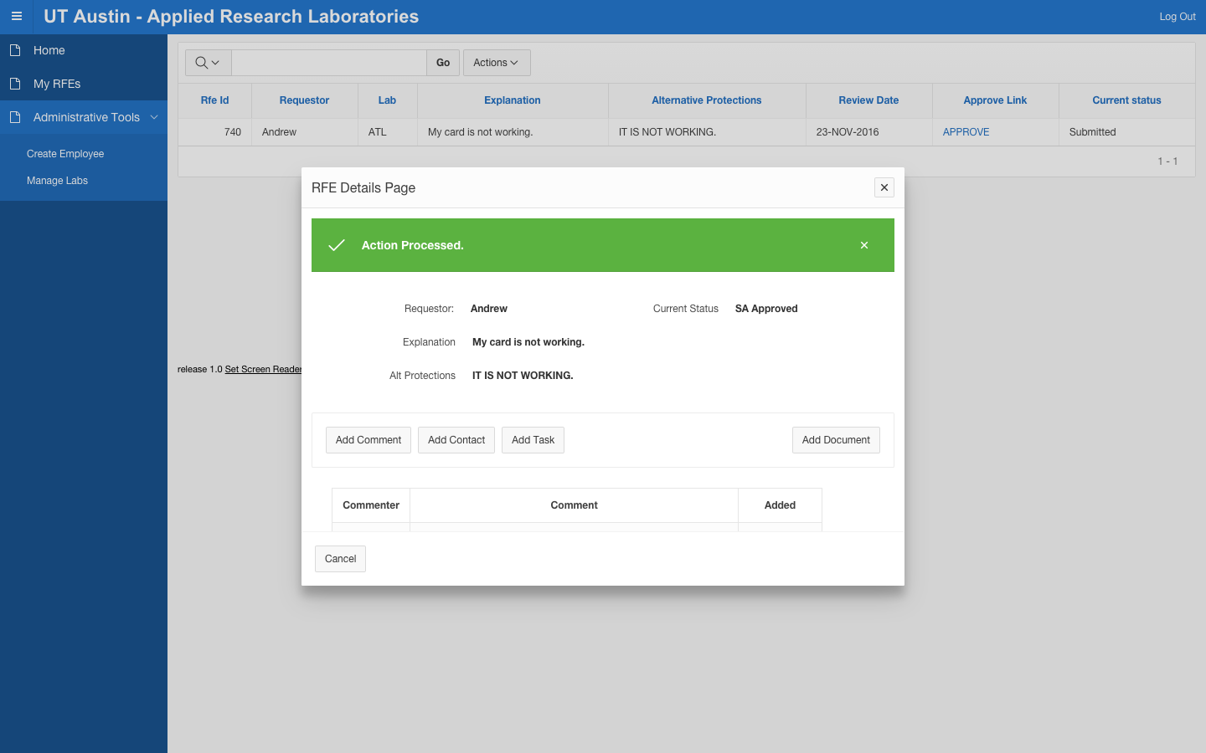

Slide 14
Live Website Link

Slide 15
Animal Database
Apex mobile application

Slide 16
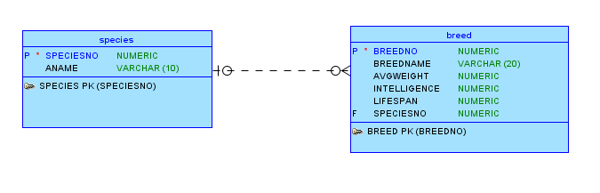
Conceptual Model
Notes:
Conceptual model

Slide 17
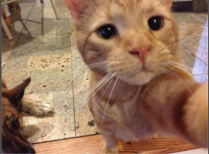

Slide 18
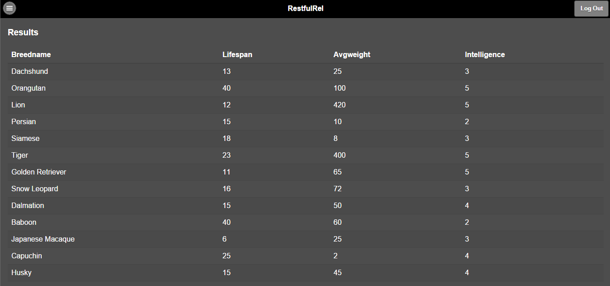
Mobile Application
Notes:
Description of part 2 with a few representative screenshots

Slide 19
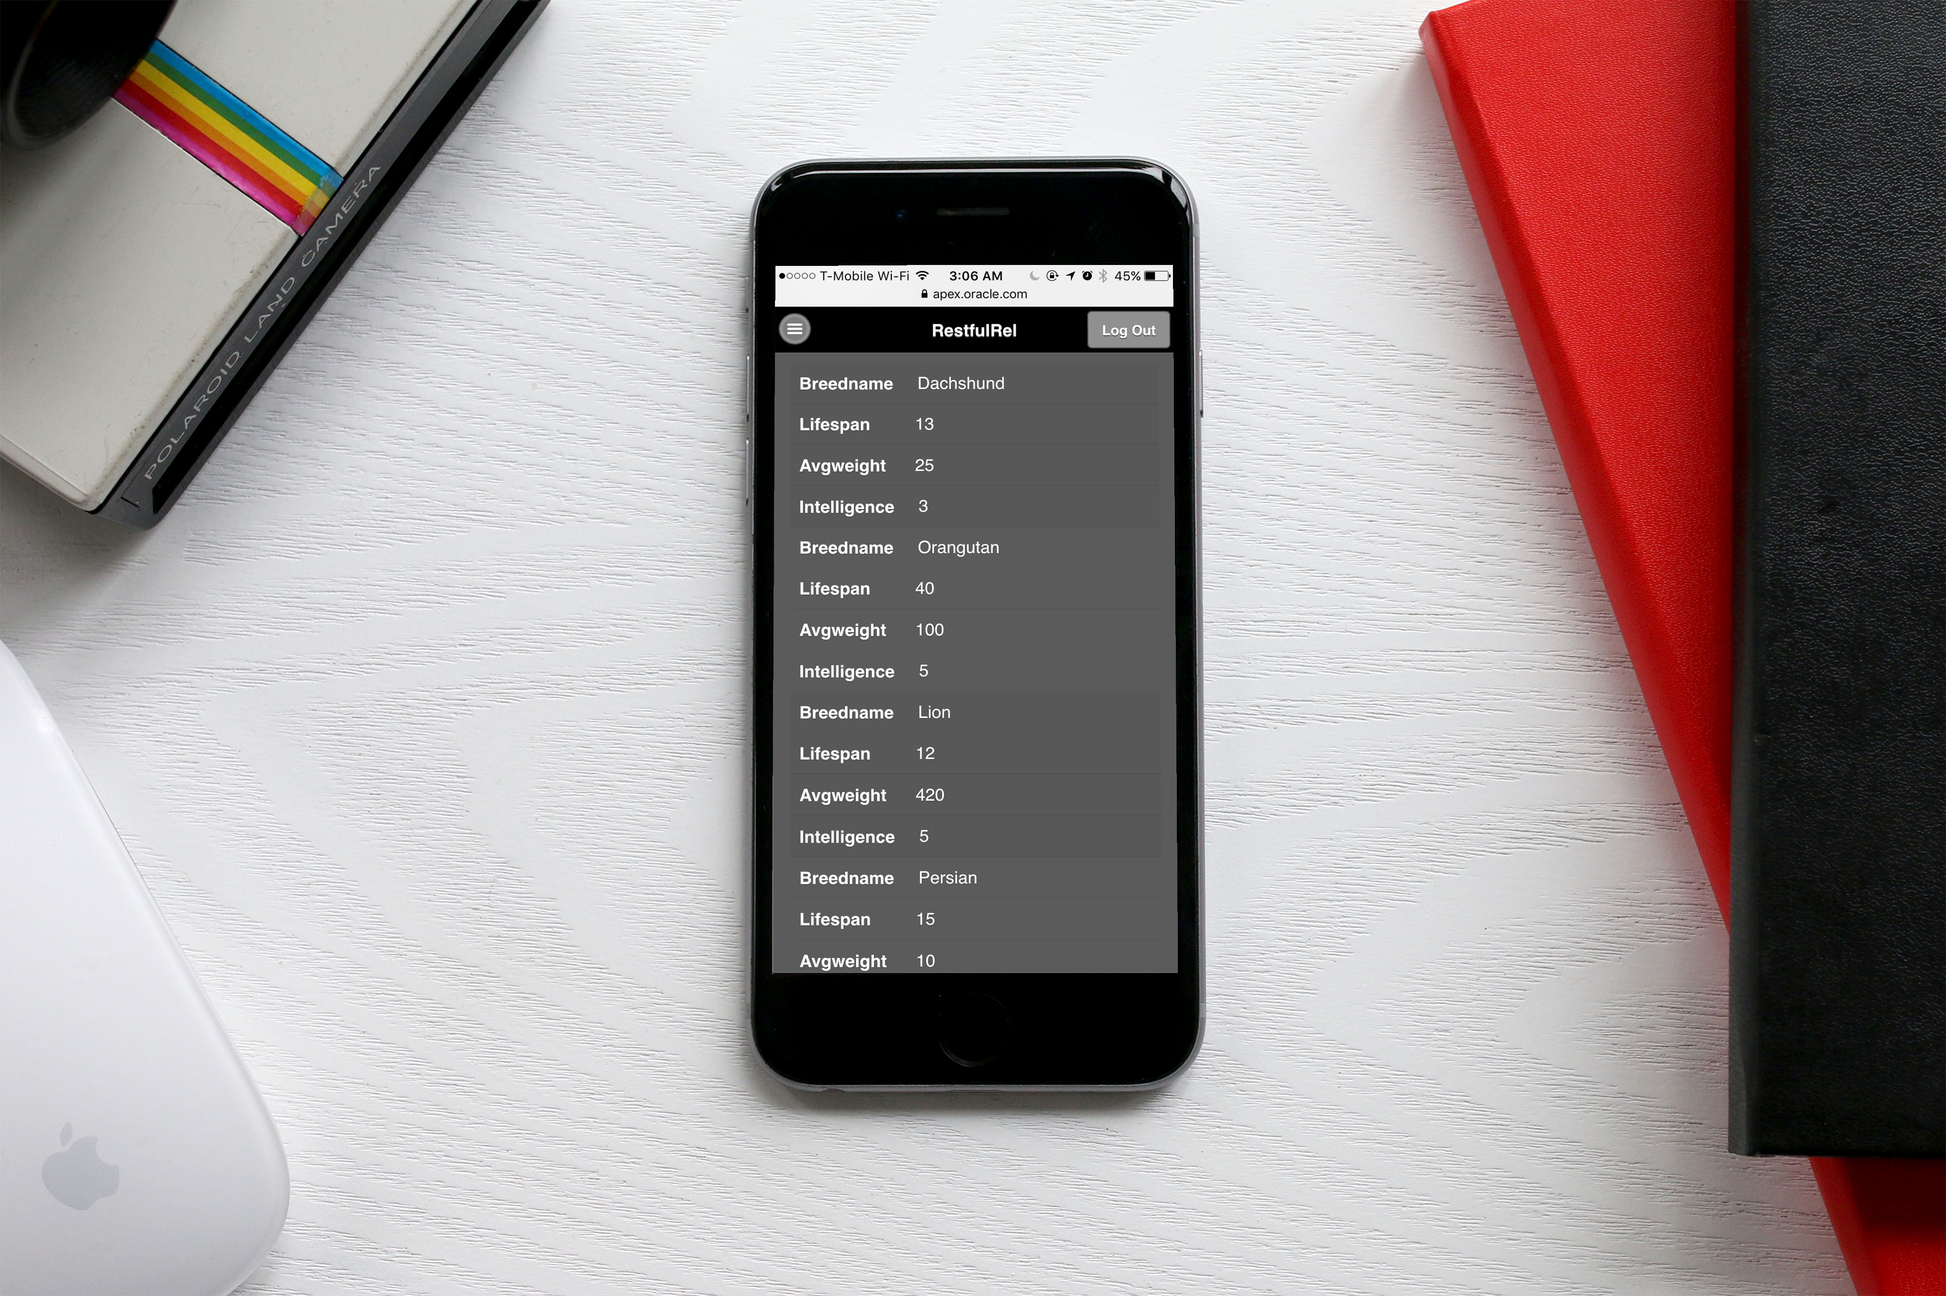

Slide 20
Live App Link

